Slide 1
CSE302: Computer Networks Project
Title:
Remote Monitoring and Controller using
RDP protocol and Java
Presented By
124003275: Sanjay Ram G
Guide Name:
Dr. R. Kavitha, CSE/SoC, SASTRA University
Date of Presentation:
13.12.2022
1

Slide 2
Points to be discussed
Aim and Objective
Problem Statement and Solution
System Configuration
Work Flow Diagram
Work Plan and Methodology
Sample Output
Result and Discussion

Slide 3
AIM & OBJECTIVES
The objective of this project is to create a remote desktop app using java language which implements the RDP protocol. Using this project, we are able to share screen and access another laptop remotely.
Objective 1: understanding RDP protocol
Objective 2: applying RDP on top of TCP, UDP network concepts
Objective 3: Creating java app
Objective 4: Benefits to the Enterprise users for secure remote desktop connection.

Slide 4

Problem Statement & Solution :
Problem statements are:
Remote application expected by the enterprise users
Can’t control devices remotely.
The Solutions are:
Required remotely controlable method is provided for the security of the app.

Slide 5
System configuration
Server
Hardware used : CPU 1 GHz or faster processor & RAM 1024MB min.
Software used : Windows OS with Java
Network : wireless
Protocol : RDP
Client
Hardware used : CPU 1 GHz or faster processor & RAM 1024MB min.
Software used : Windows OS with Java
Network : wireless
Protocol : RDP

Slide 6
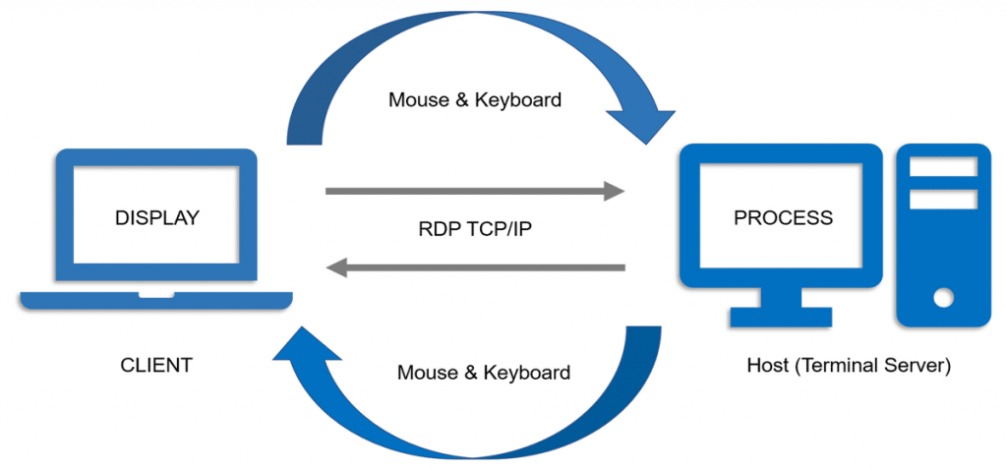
Work Flow Diagram

Slide 7
Work Plan and Methodology
To begin with, we need to capture the screen of server and send it to the client.
Then, the actions like key press and mouse movements are captured at runtime in client’s side and it is send to the server.
There is a class called robot in java, which can be used to perform the actions received from the client in server side.
By these classes and methods, Screen Sharing and Remote Controller can be implemented in Java.

Slide 8
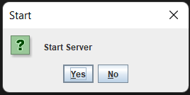
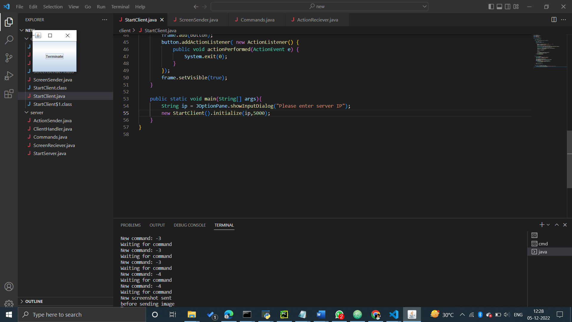
Sample Output:
Server :

Slide 9
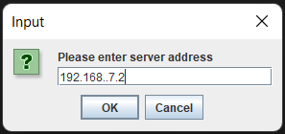
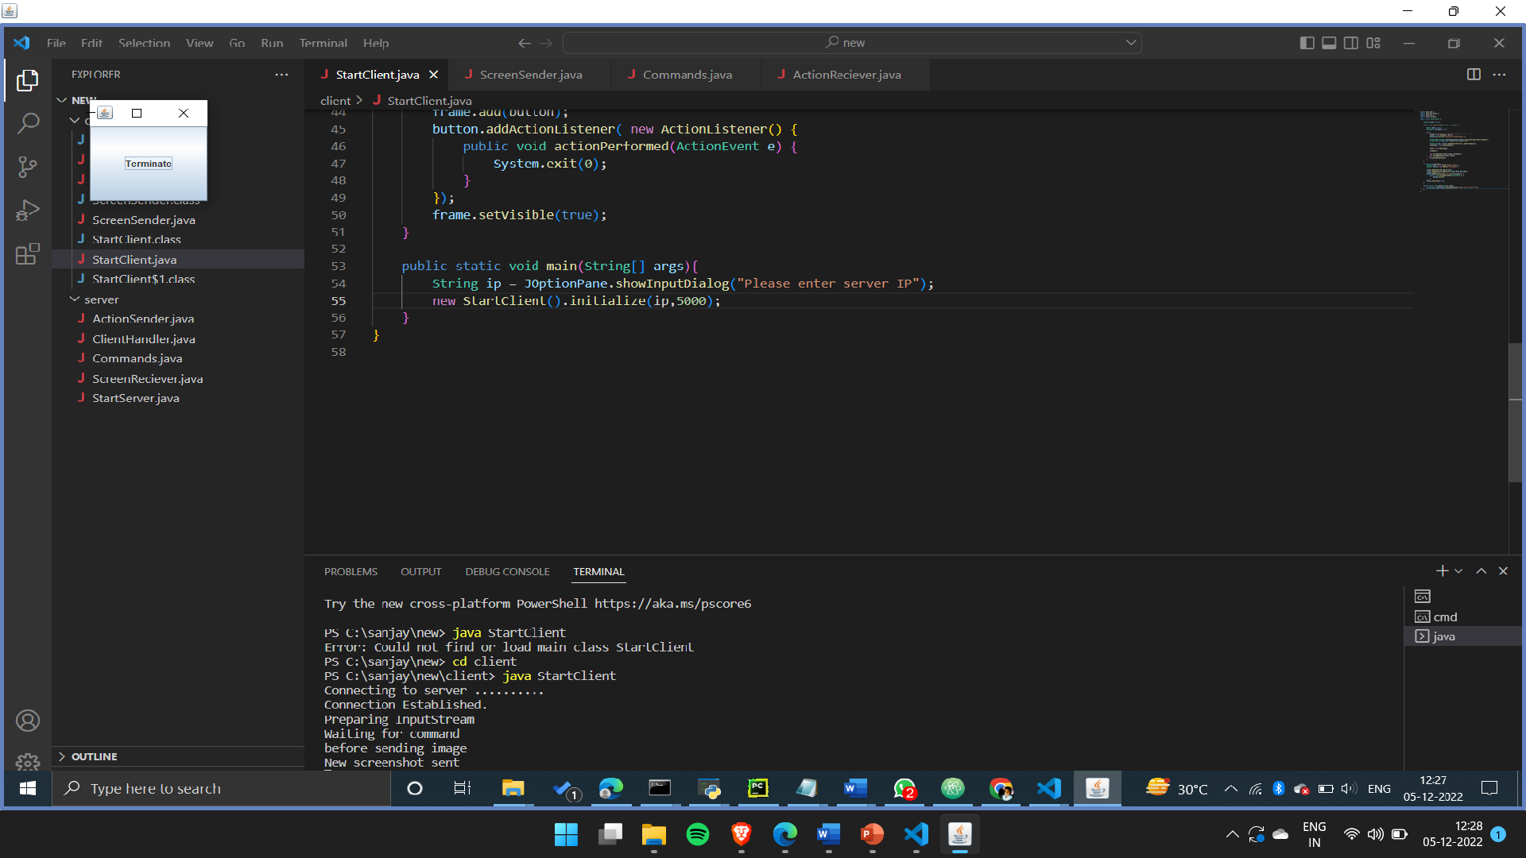
Client :

Slide 10
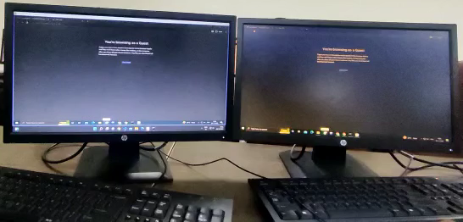
Output video :

Slide 11
Result and Disscussion
Result:
It is also found that the system has been working effectively after implementing the protocols
RDP protocol after checking, it has been established that it has achieved the desired output with no error.
Discussion:
The current usefulness mainly meant for environments of intranet, for example virtual classrooms is also comes under huge range of application areas of intranet environments.
Additionally, differences target to take account of abilities such as controls and extra operator controls on the Remote systems.

Slide 12
Thank You

